Slide 1
Using the Enterprise Integrtion Patterns

Slide 2
Using the Enterprise Integration Patterns
Aggregator
Splitter
Routing Slip
Dynamic Router
Load Balancer

Slide 3
Aggregator and Splitter
Aggregator Used to combine results of individual but related messages into a single outgoing message.
The Splitter can split out a single message into multiple submessages, and the Aggregator can combine those submessages back into a single message. They’re opposite patterns.
The EIPs allow you to build patterns LEGO style, which means that patterns can be combined together to form new patterns. For example, you can combine the Splitter and the Aggregator into what is known as the Composed Message Processor EIP, as illustrated in figure

Slide 4
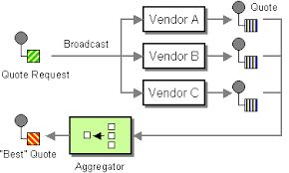

Slide 5
Routing Slip
In Camel mailing list routing the messages dynamically is done by using EIPs such as Recipient List, Routing Slip, and Dynamic Router.
The Routing Slip and Dynamic Router patterns.
The Routing Slip from the EIP patterns allows you to route a message consecutively through a series of processing steps where the sequence of steps is not known at design time and can vary for each message.

Slide 6
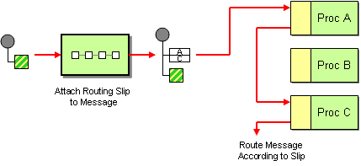

Slide 7
Name | Default Value | Description
uriDelimiter | , | Delimiter used if the Expression returned multiple endpoints.
ignoreInvalidEndpoints | false | If an endpoint uri could not be resolved, should it be ignored. Otherwise Camel will throw an exception stating the endpoint uri is not valid.
cacheSize | 1000 | Camel 2.13.1/2.12.4: Allows to configure the cache size for the ProducerCache which caches producers for reuse in the routing slip. Will by default use the default cache size which is 1000. Setting the value to -1 allows to turn off the cache all together.

Slide 8
Dynamic Router
Dynamic Routing – making routing decisions at runtime
When you need to route to a sequence of endpoints, and that list may change based on the response from any of those endpoints, a Dynamic Router can be a good solution. Similar to a Routing Slip, where a list of endpoints to route to is created and executed, the Dynamic Router can alter the next endpoint to route to, based on the results of previous endpoints via a feedback loop.

Slide 9
One-way route waiting on a request-response endpoint
Assume that you have a route that uses the InOnly Message Exchange Pattern (MEP).
The consumer that fed a message into the route expects no response. Any endpoint listed
in the route will, as a consequence, be invoked with the InOnly MEP

Slide 10
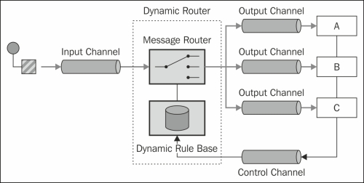

Slide 11
Load Balancer The Load Balancer Pattern
Allows you to delegate to one of a number of endpoints using a variety of different load balancing policies.

